Slide 1
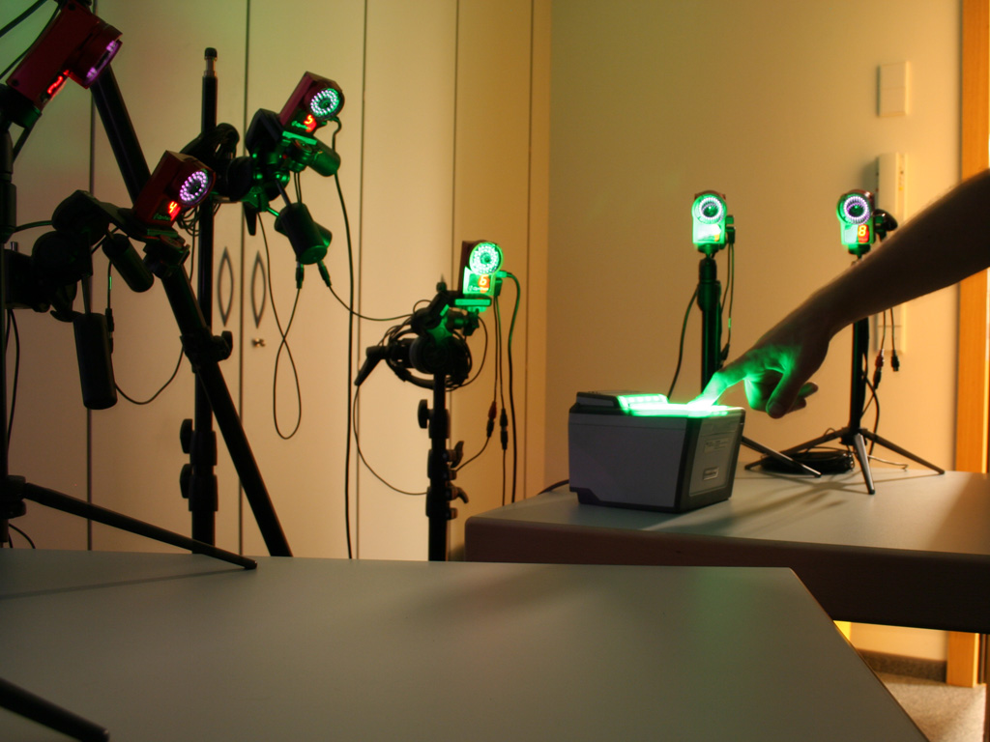

high-precision touch input
based on fingerprint recognition
christian holz
patrick baudisch
Notes:
1

Slide 2
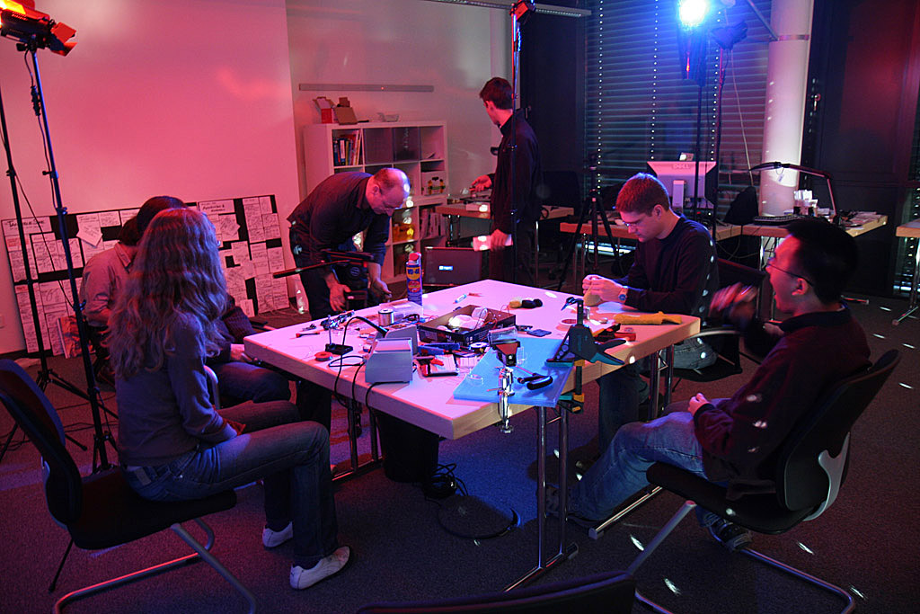

fachgebiet human-computer interaction

Slide 3
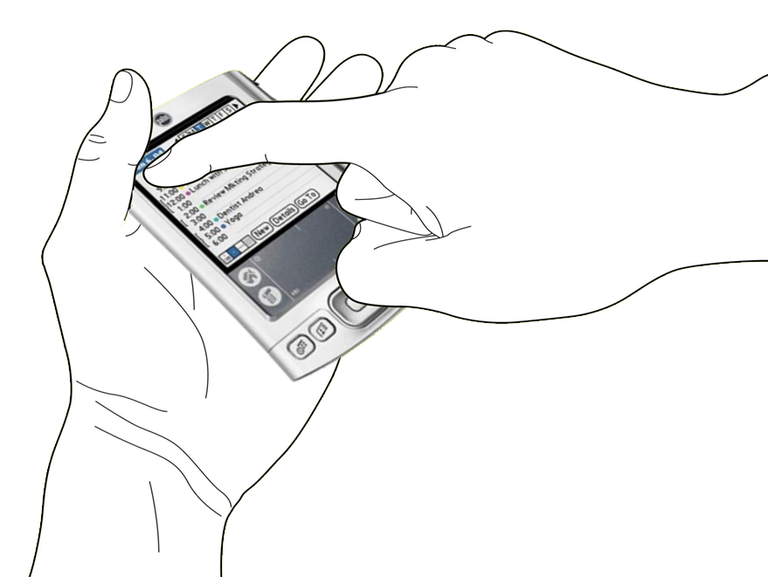
occlusion

Slide 4
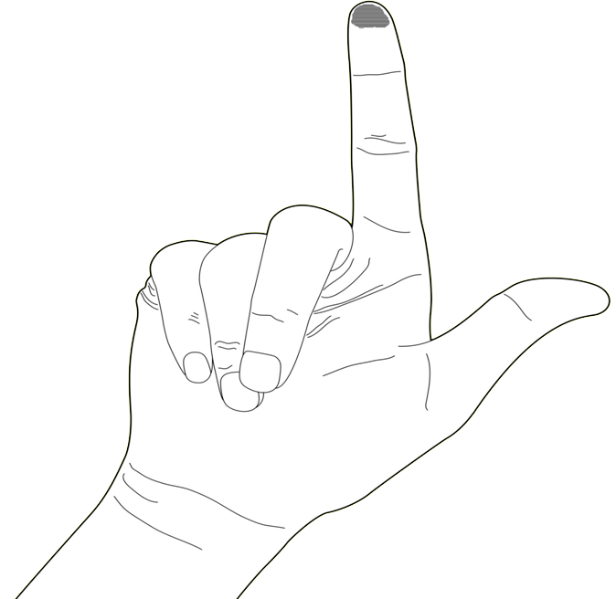
fat finger

Slide 5
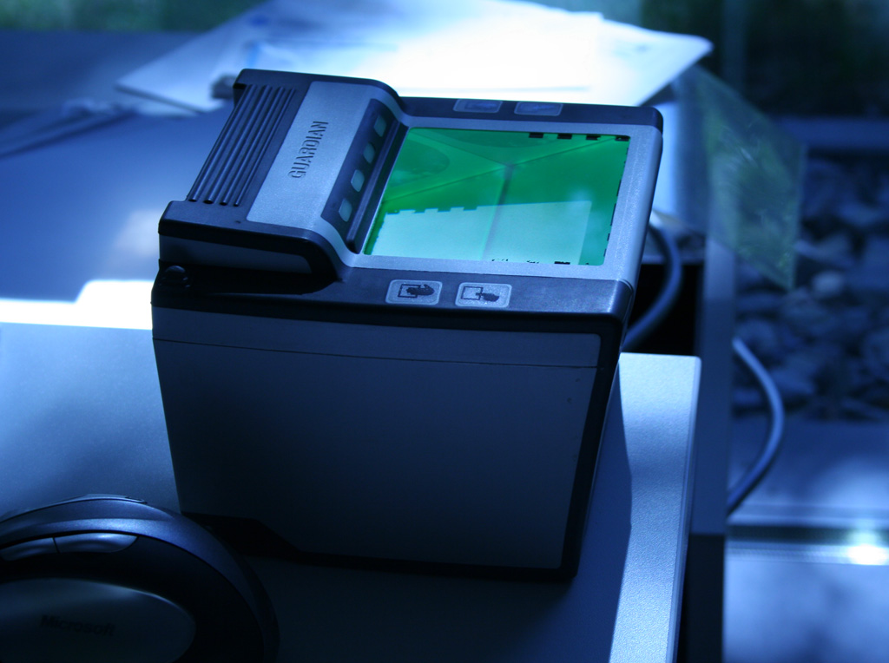
so touch is inaccurate
or is it?

Slide 6
could it be
that it is not the fingers
but our touch devices that are wrong?

Slide 7
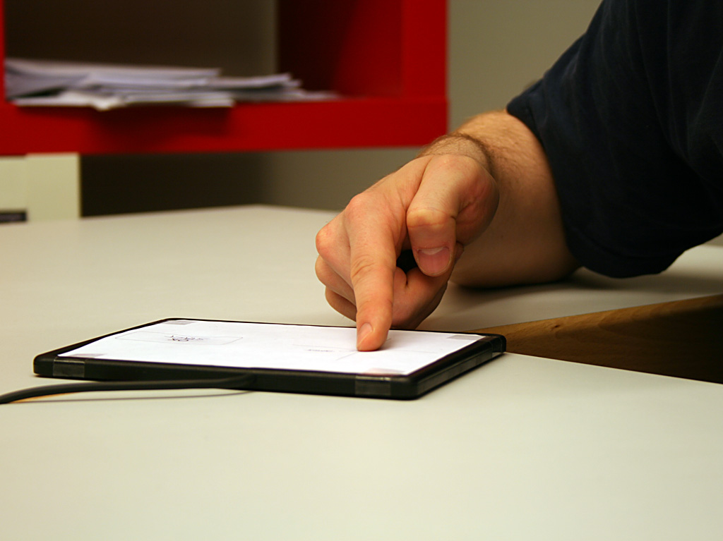
Part 1 (science):
even though screens are 2D, pointing is not
Part 2 (engineering):
sensing fingers in 3D → highly accurate touch

Slide 8
we claim there is
no fat finger
problem

Slide 9
instead, almost all observed targeting error comes from
perceived
input point
problem

Slide 10
perceived input point problem
[Benko, Wilson, & Baudisch 2006]
target
touch device perceives

Slide 11
why we hope it’s the perceived input point problem?
offset
we can correct for it
the fat finger problem, in contrast is always noise = error

Slide 12
why we hope it’s the perceived input point problem?
offset
we can correct for it
the fat finger problem, in contrast is always noise = error

Slide 13
our main hypothesis
while there is always an offset, we hypothesize that
the offset depends on the pointing situation

Slide 14
so what does “pointing situation” mean?

Slide 15
1
yaw
!=
[iPhone, Wang et al.]

Slide 16
2
pitch
!=
[Forlines et al., CHI’07]

Slide 17
3
roll
!=

Slide 18
4
finger shape
!=

Slide 19
4
mental model
!=

Slide 20
(… and there might be more
e.g., head position/parallax…)

Slide 21
a non 2D-model
user study
we ran a

Slide 22
current model
xy
xy
touch pad
screen

Slide 23
proposed model
nD
xy
touch pad
screen

Slide 24
user study 1
user study
we ran a

Slide 25
task

Slide 26
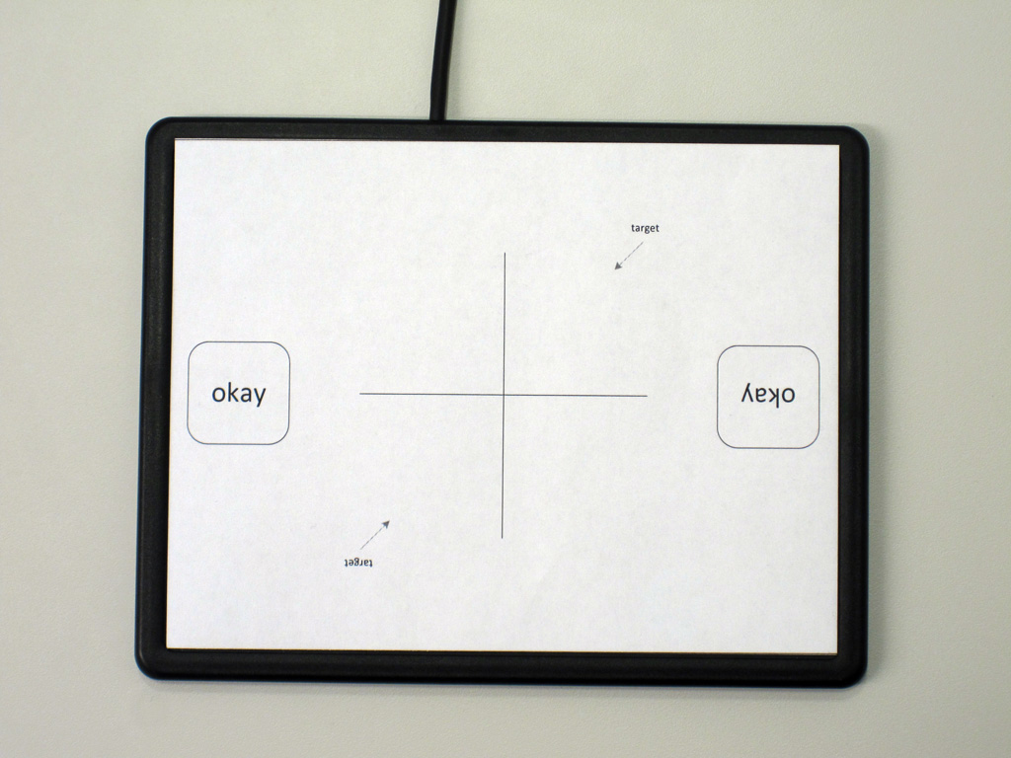
1. target here
2. hit okay
task

Slide 27
1
pad rotation (yaw)

Slide 28
2
roll
roll
90°
45°
15°
0°
-15°

Slide 29
3
pitch
90°
65°
45°
25°
15°

Slide 30
4
user
12 participants
(all students, so differences
among them will be lower bound)

Slide 31
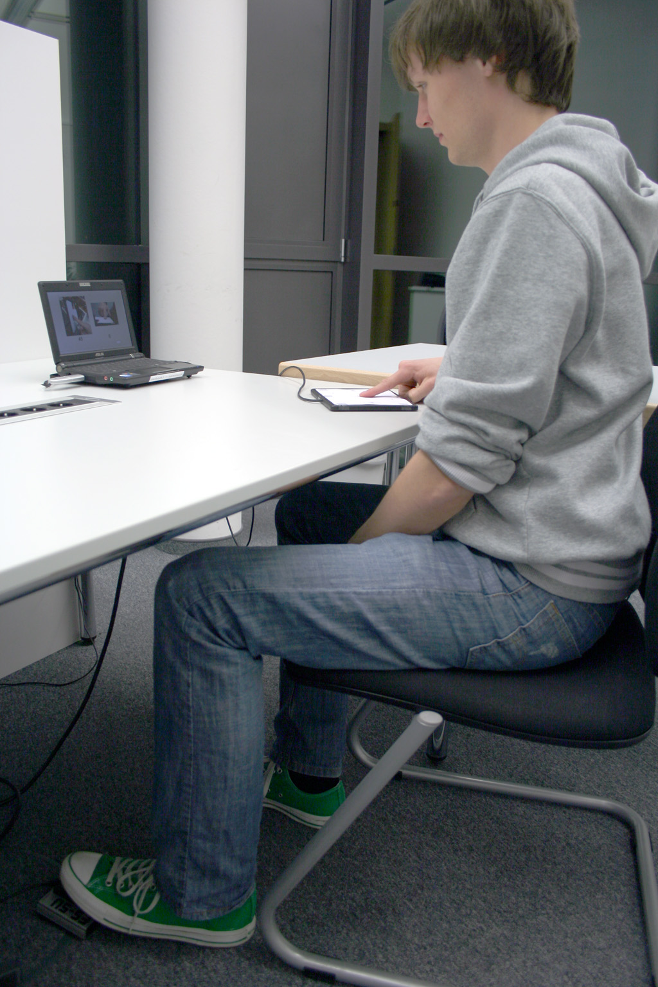
controlled
head position
→ parallax
on-screen
instructions
capacitive
touch pad
footswitch

Slide 32
dependent
every trial recorded as a dot at the touch location

Slide 33

we measure targeting accuracy assuming perfect calibration
→ size of ellipse that contains 95% of all samples.
example
7.5 mm
1.5 cm

Slide 34
hypotheses
main effects for
roll, pitch, yaw, & participantID

Slide 35
2 pad rotations
× 2 sessions (pitch, roll)
× 5 angles
× 6 repetitions per angle
× 5 blocks
= 600 trials / participant
12 participants
design

Slide 36
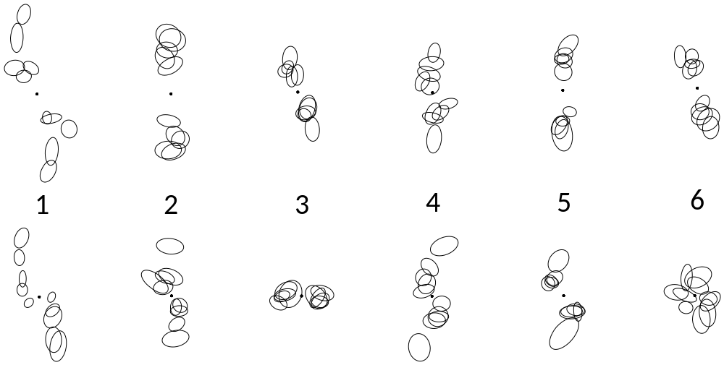
results

Slide 37
if the additional IVs had no impact,
we would expect to see something like this

Slide 38
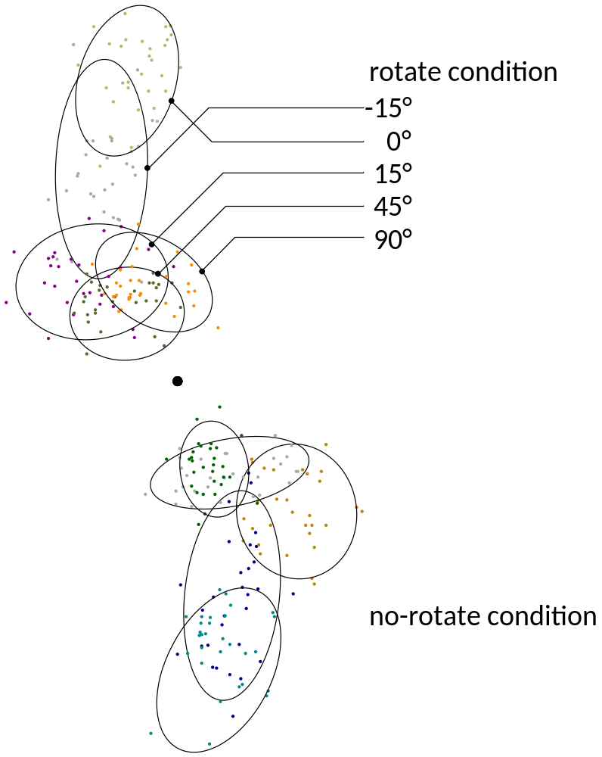
but touch locations do indeed fall into clusters…

Slide 39
results
requires 15mm button
requires 5.2mm button
button size in cm for 95% accuracy
~three times more accurate
allow three times smaller device
traditional
capacitive
error bars are standard deviation

Slide 40
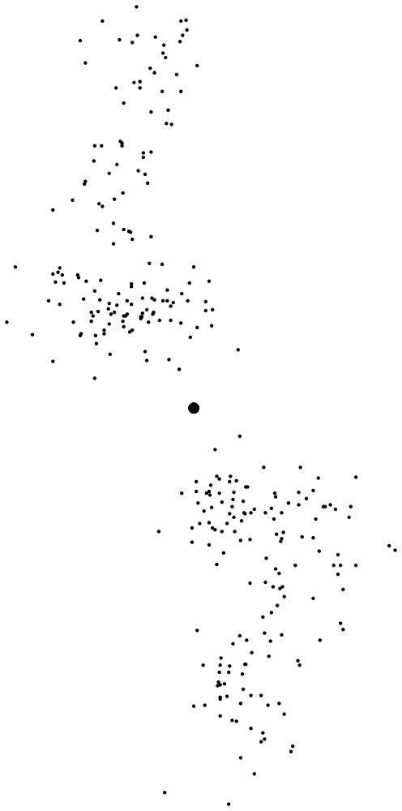

1
pad rotation (yaw)
target
1cm
(participant #4, roll varied)

Slide 41
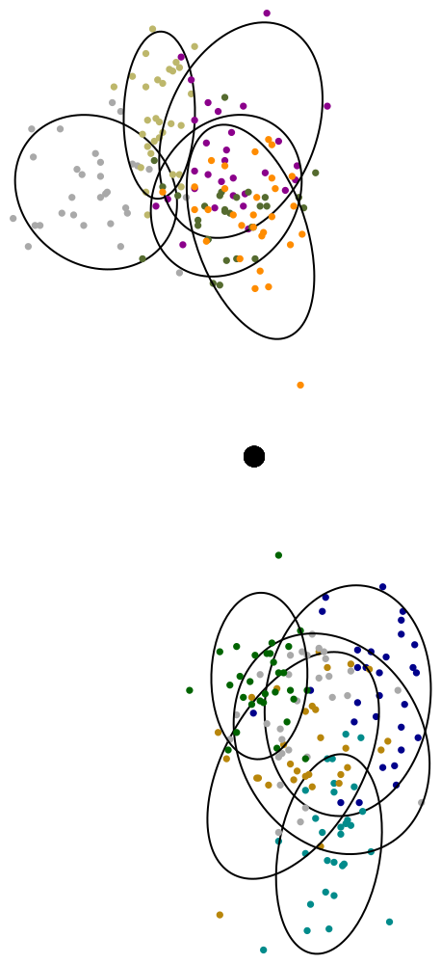
1
pad rotation (yaw)

Slide 42
2
roll
(participant #4, roll only)

Slide 43
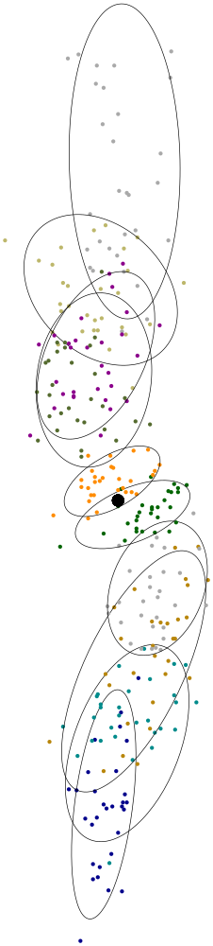
3
pitch
10
25
45
65
90
1cm

Slide 44
4
users
all data by participant #1-6
roll
tilt

Slide 45
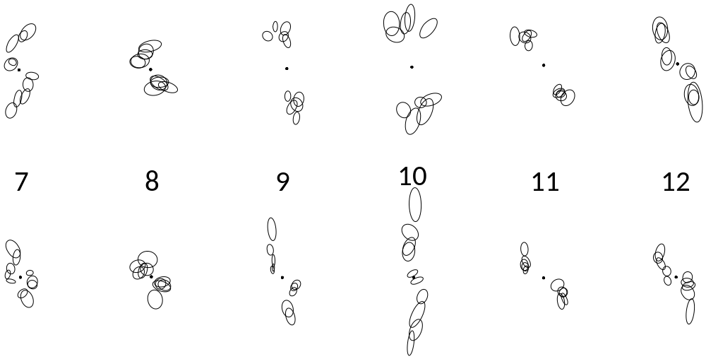
4
users
all data by participant #7-12
roll
tilt

Slide 46
results
requires 15mm button
spread in cm
requires 5.2mm button
traditional
capacitive
error bars are standard deviation

Slide 47
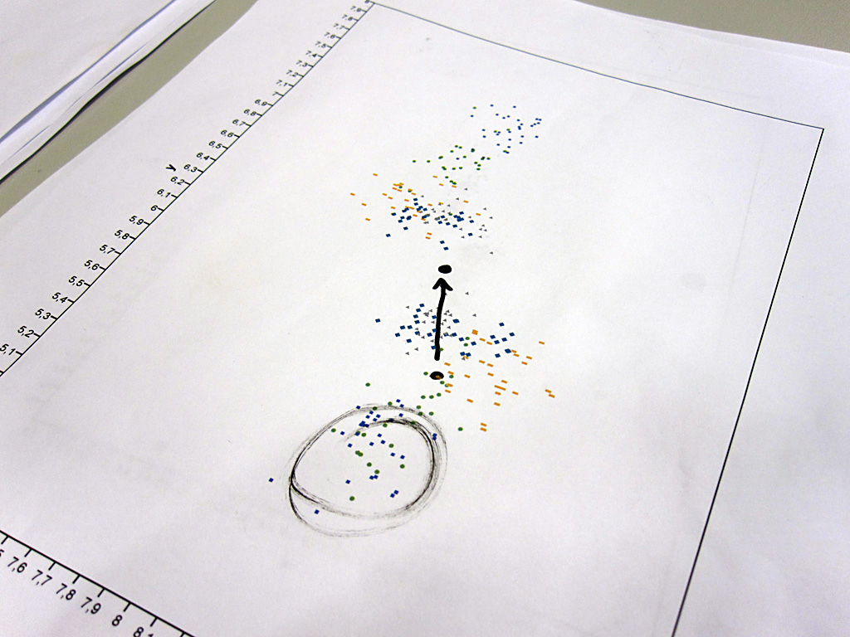
how (in)accurate current devices are (button must be that big)
if we knew the
pad orientation
if we knew
finger angles

Slide 48
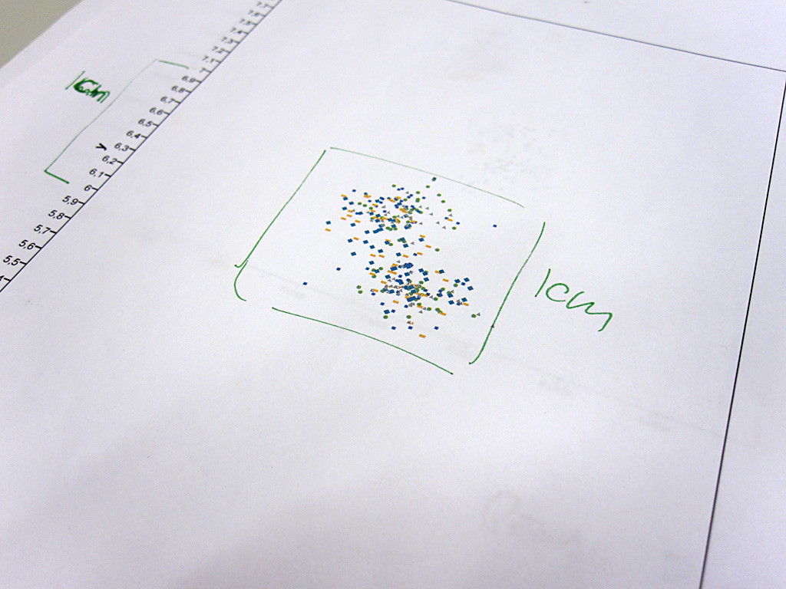
also need to know user ID, or we will overcompensate for people like this one
shouldn’t we be able to make such a device?

Slide 49
Part 1 (science):
even though screens are 2D, pointing is not
Part 2 (engineering):
sensing fingers in 3D → highly accurate touch

Slide 50
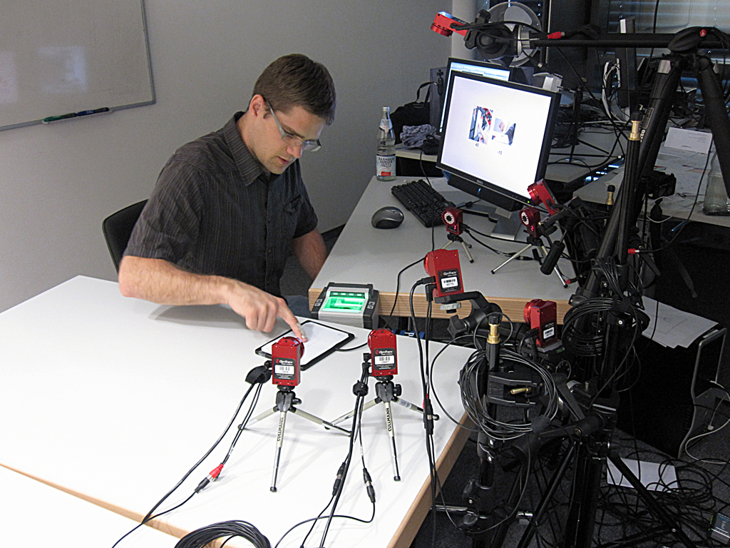
what do you mean: “not very practical”?
retro reflective markers on finger… 6-16 camera setup…
makes a great “gold standard” implementation to test the concept
optical tracker

Slide 51
mobile
ok, maybe something a bit more

Slide 52
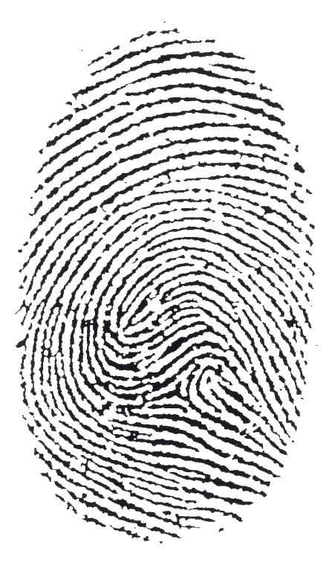

Slide 56
gets everything a traditional touchpad gets
+ roll, pitch, yaw, & participantID

Slide 57
devices that sense touch and fingerprint already exist

Slide 58


Slide 59
→ this is very different from micro rolls [CHI 2009]

Slide 60
algorithm
calibration
have user touch a known target repeatedly and with different finger postures → create database of (fingerprint, target offset)
use
obtain fingerprint as user touches the device
look up similar fingerprints in the database
aggregate associated offsets (k nearest neighbor) and apply it

Slide 61
user study 2

Slide 62
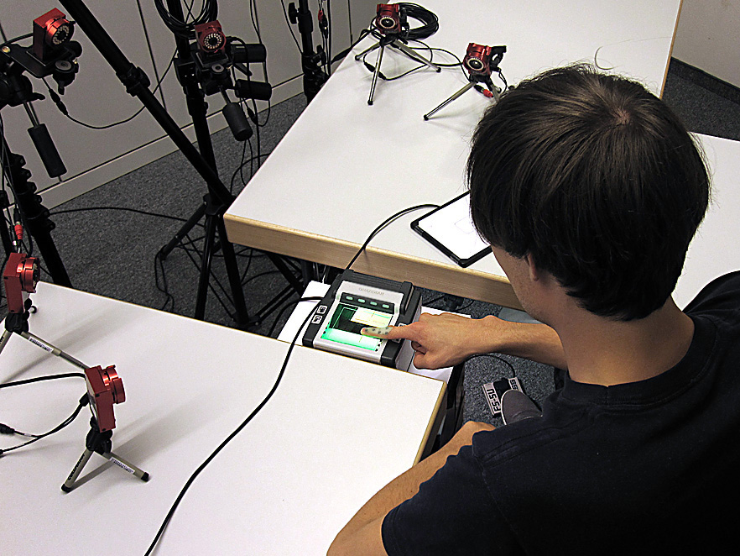
1
tracking device
fingerprint
optical tracker
“simulated capacitive”
(just contact area)

Slide 63
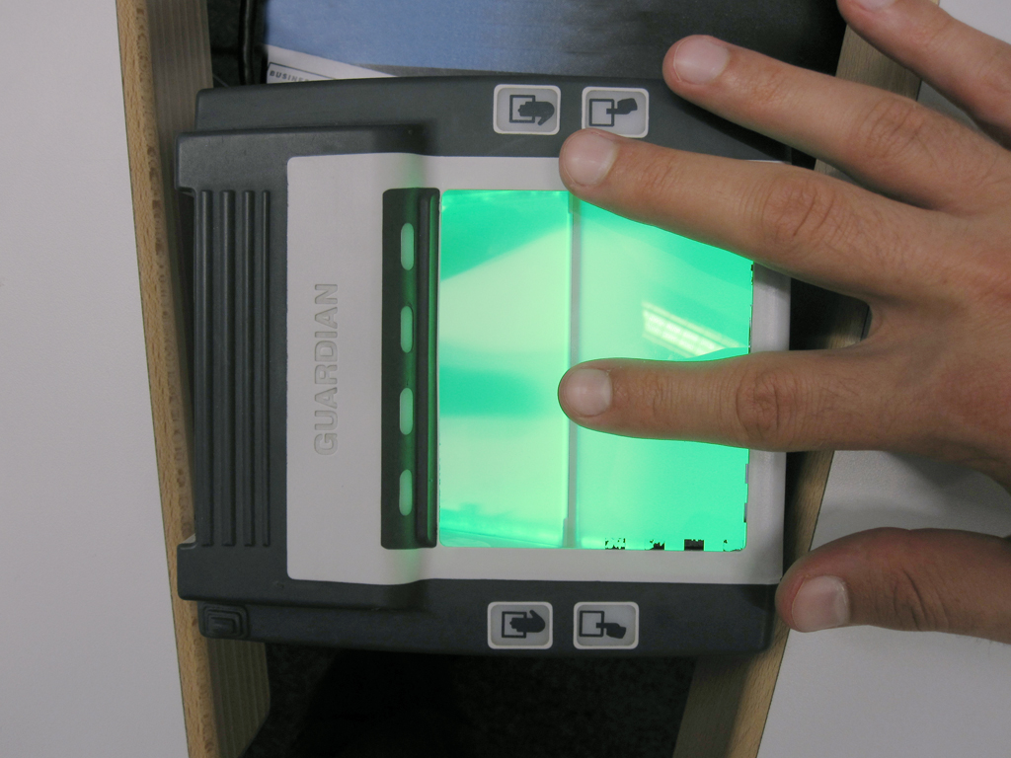
2
rotation

Slide 64
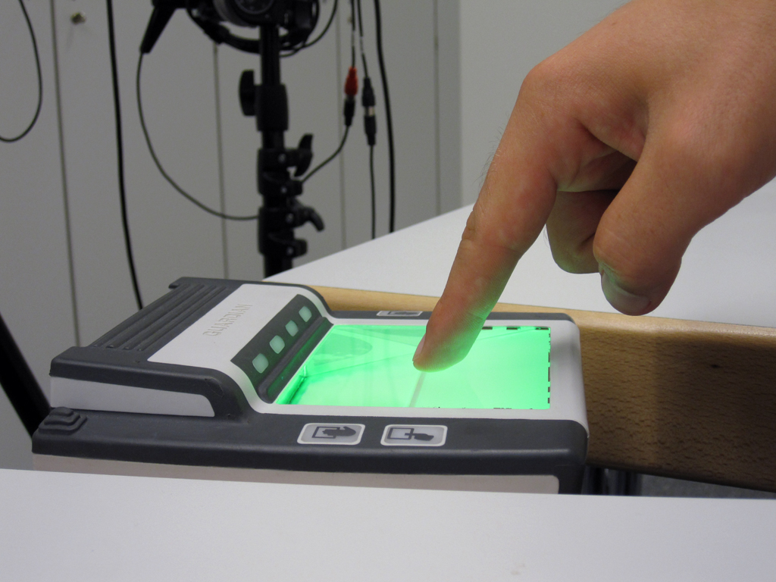
3
roll & pitch
roll |  | -15° | 0° | 15° | 45° | 90°
pitch
15° |  | × | × | × | × | ×
25° |  |  | ×
45° |  | × | × | × | × | ×
65° |  |  | ×
90° |  |  | ×

Slide 65
hypotheses
optical beats simulated capacitive by ~3x
(based on user study 1)
fingerprint beats simulated capacitive
(let’s find out by how much)

Slide 66
2 rotations
× 13 angles
× 5 repetitions per angle
× 5 blocks
= 650 trials / participant
12 participants
design

Slide 67
results

Slide 68
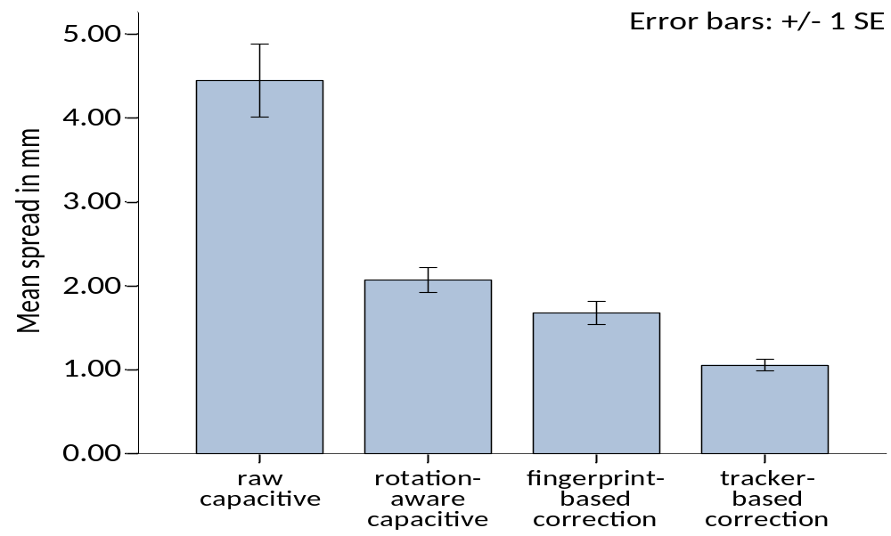
results
spread in cm
as expected a factor of 3x
potential for improvement
works!
simulated
capacitive
fingerprint
optical
error bars are standard deviation

Slide 69
conclusions

Slide 70
benefits
use roll/pitch/yaw/userID touch device to
1. make more reliable touch input devices
enter text on mobile touch device with high accuracy
2. avoid need for targeting aids
such as offset cursor, shift, zooming,
as they cost time and make touch less “direct”
3. make smaller mobile touch devices
bring touch input to watch-size mobile devices

Slide 71
model
2/3 (7/8 of surface) of “fat finger problem”
really stem from an oversimplified model of touch
touch is not 2D

Slide 72
next steps
find a closed representation of user profile → speed up learning
combine with in-cell touch screens → make small

Slide 73
thanks to my new group at
hasso plattner institute
in berlin/potsdam
fachgebiet human-computer interaction

Slide 74
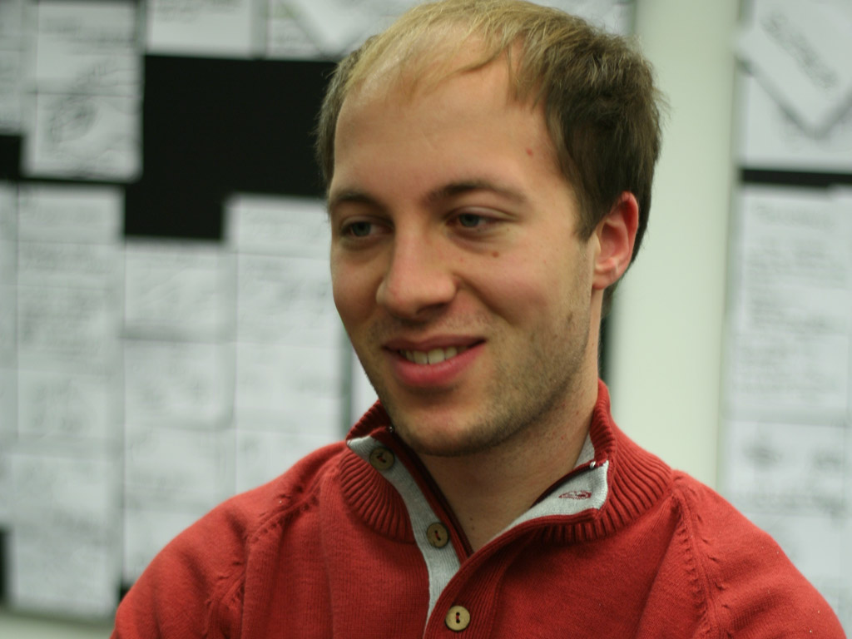
Christian Holz
  Ph.D. Student, masters from Hasso Plattner Institute
  Masters project with Steve Feiner at Columbia University, New York
  .

Slide 75
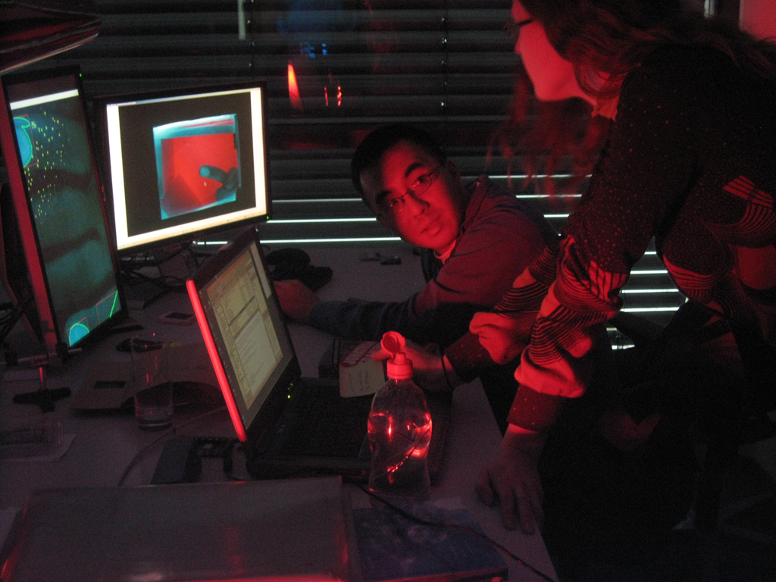
Gerry Chu
  intern at Hasso Plattner Institute
  Masters from U of Toronto
  .

Slide 76
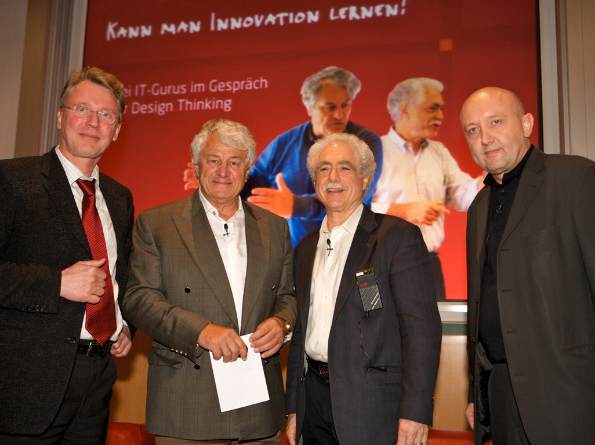

Slide 77
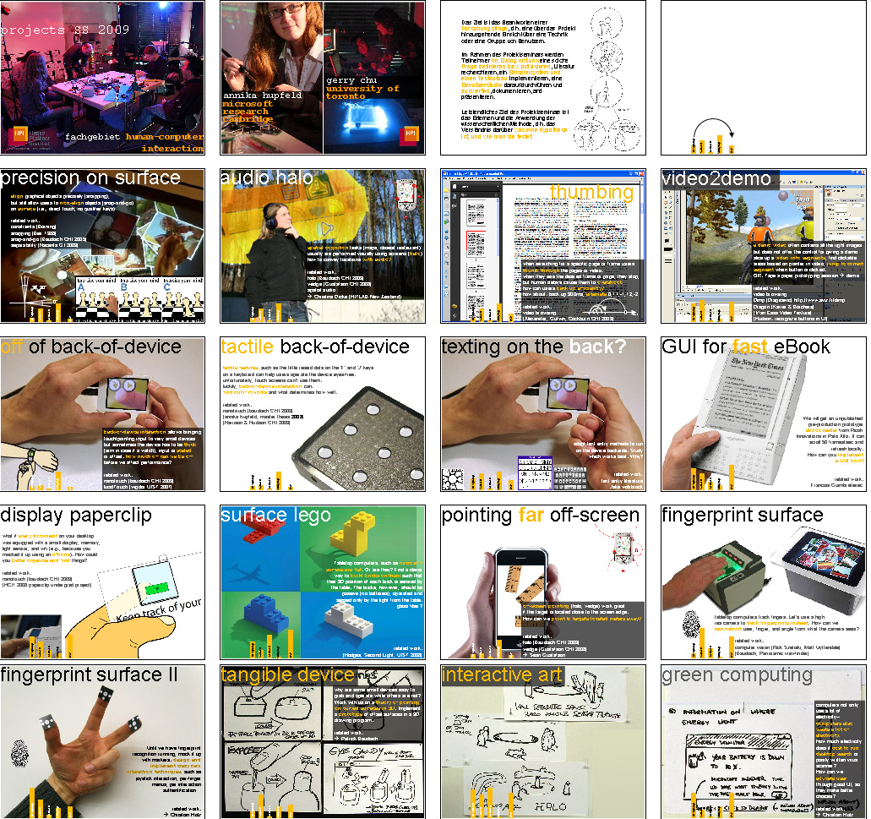
come visit
  joe konstan: university of minnesota
  daniel fisher: microsoft research
  gary marsden: south africa, capetown
  michael rohs: telekom labs
  scott klemmer: stanford
  mark billinghurst: hitlab new zealand
  lucia terrenghi: vodaphone
Notes:
77

Slide 78
open Ph.D./
post doc position
fachgebiet human-computer interaction

Slide 80
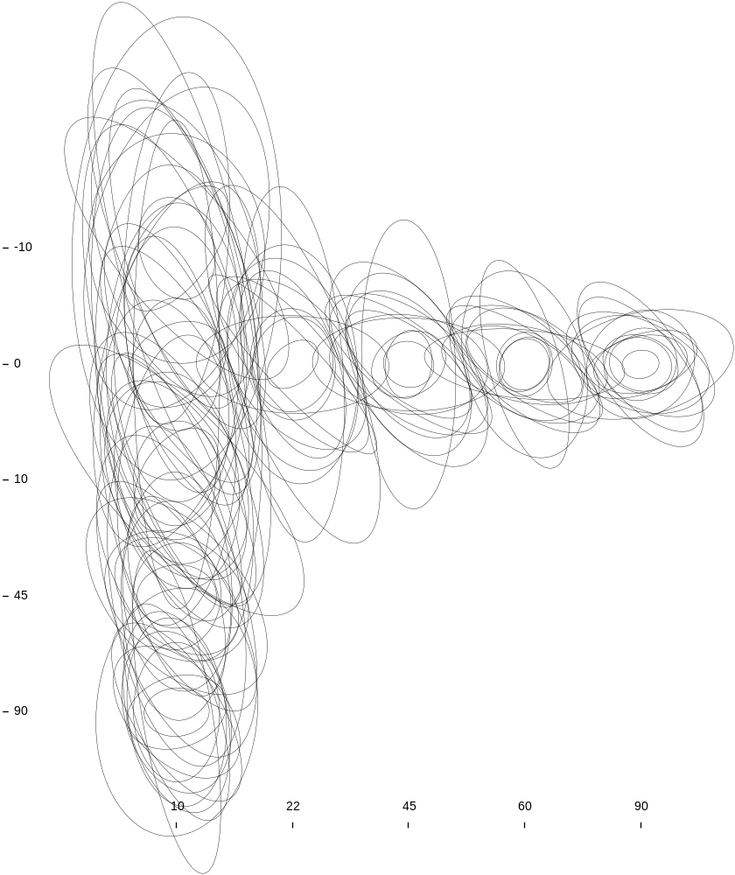
all people
without sense of rotation

Slide 81
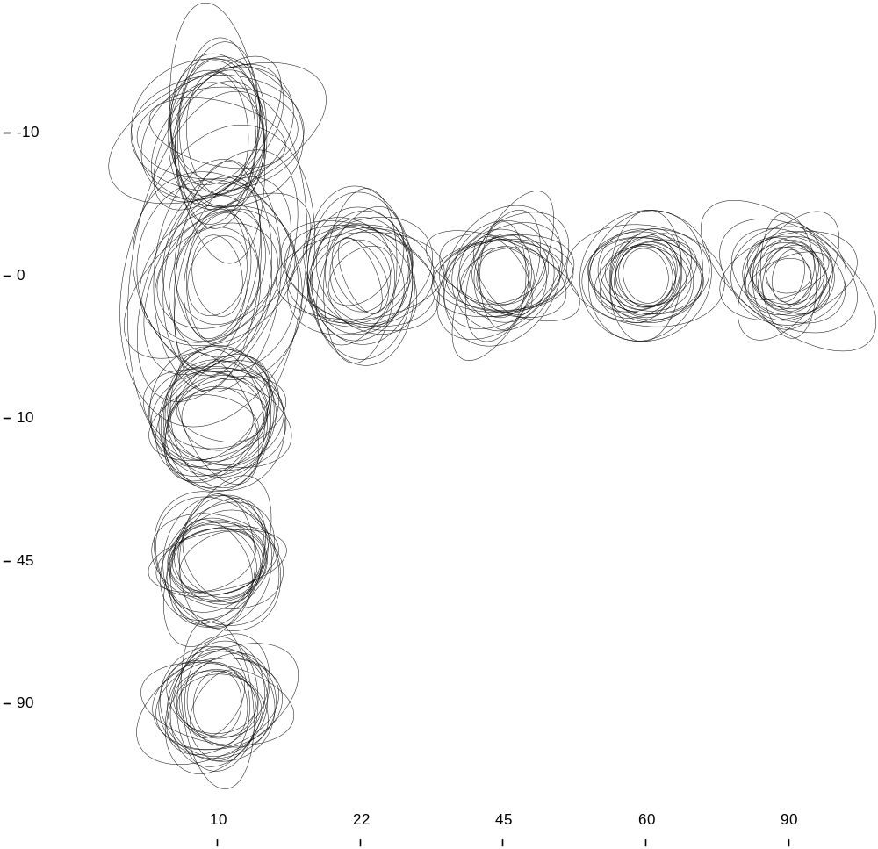
all people
with sense of rotation

Slide 82
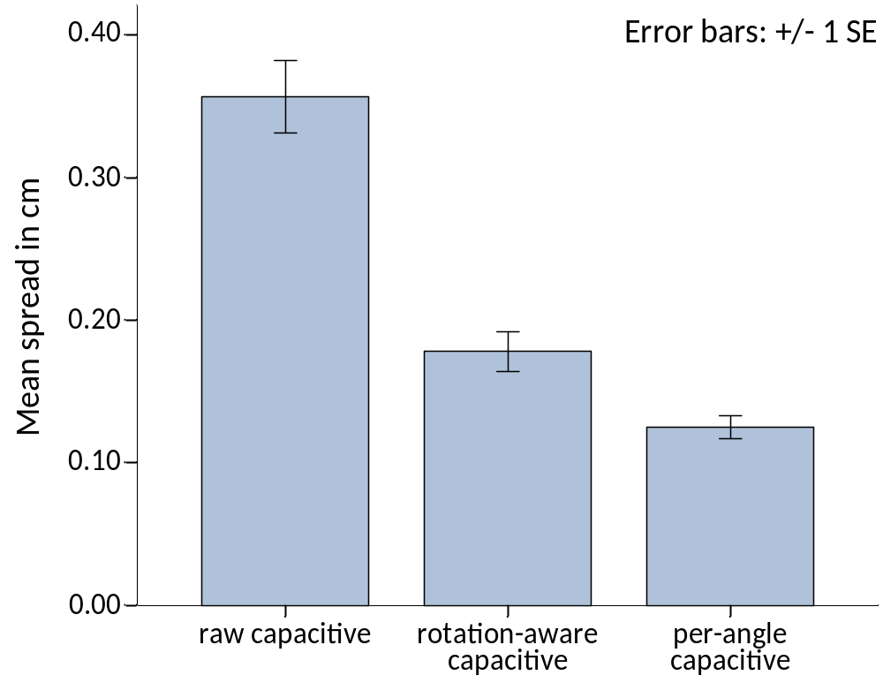
per user spread

Slide 83
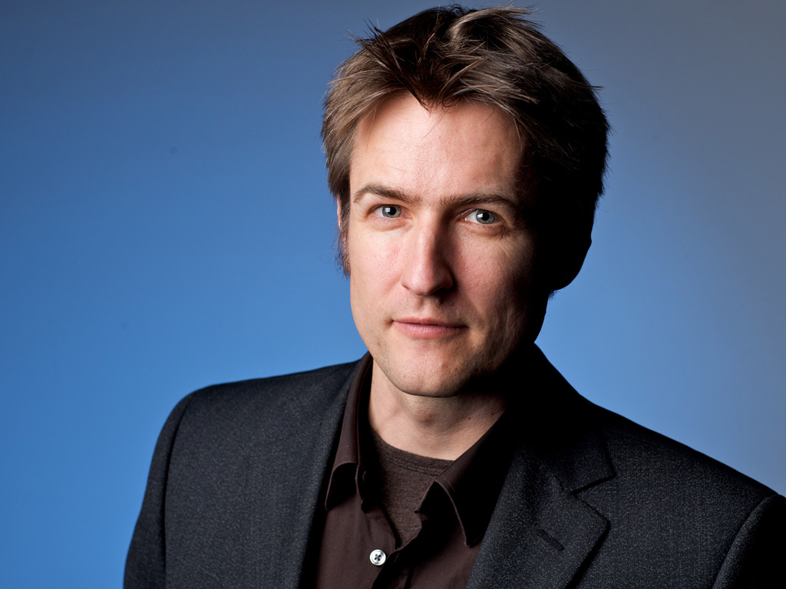
patrick
baudisch
  Professor in computer science at Hasso Plattner Institute
  2002- research scientist at Microsoft Research, Redmond, WA
  2003- affiliate professor at University of Washington Seattle, WA
  2000-2002 research scientist at Xerox PARC
  2000 Ph.D. in computer science from TU Darmstadt

Slide 84
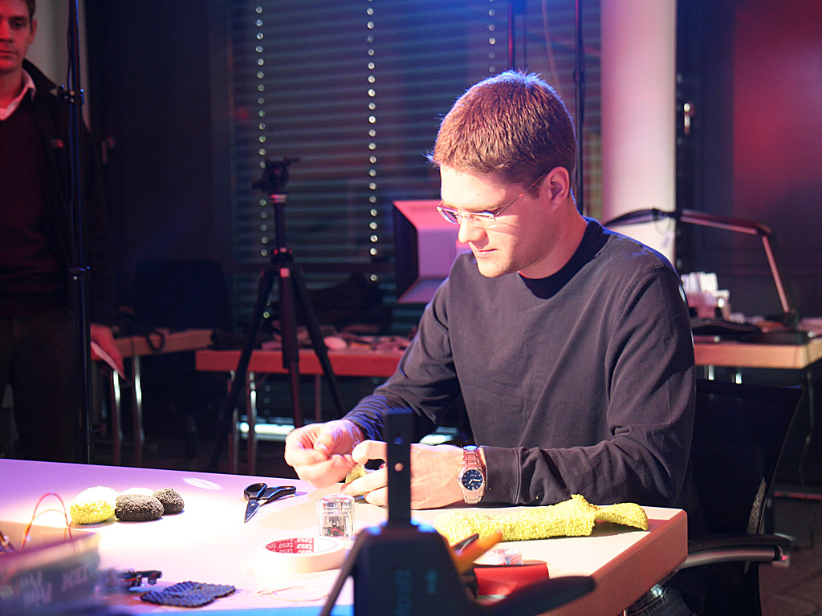
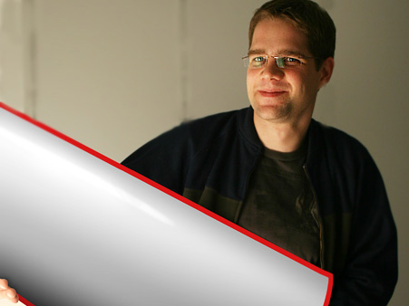
spatial cognition
on mobile
Sean Gustafson
  Ph.D. Student
  Masters University of Manitoba, Canada on visualization, off-screen pointing
  .

